Slide 1


Moving advanced analytics to your SQL Server databases
Enrico van de Laar
We mind your data while you mind your business.
www.datamasterminds.io

Slide 2

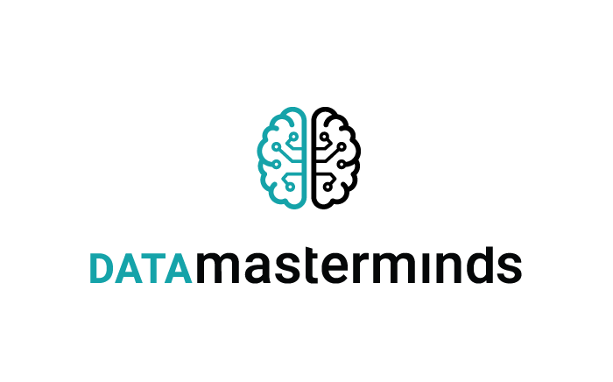









Slide 3


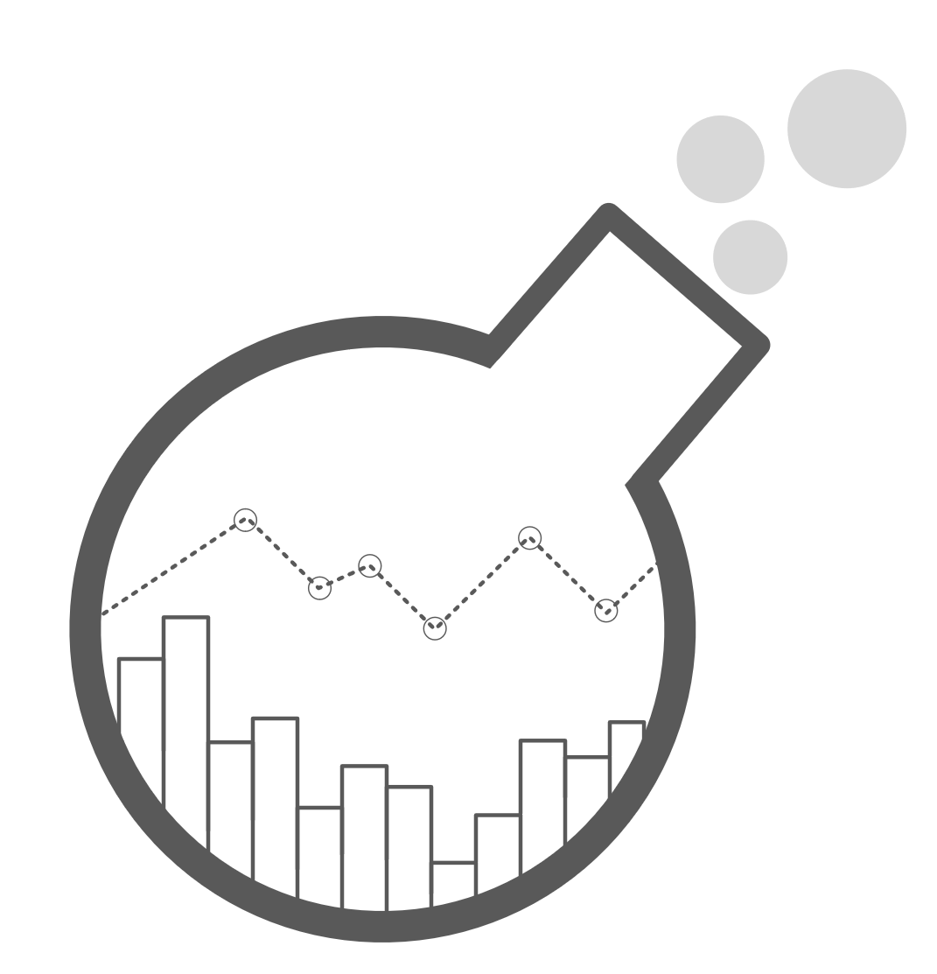
About
Enrico van de Laar
Co-Founder | Data & Advanced Analytics Consultant @ Data Masterminds
Crazy Data Scientist
Microsoft Data Platform MVP
Author
Speaker
Blogger
Twitter: @evdlaar
Email: enricovandelaar@datamasterminds.io Web: http://www.dotnine.net
www.crazydatascience.com
www.datamasterminds.io
Moving Advanced Analytics to your SQL Server databases

Slide 4
Plan for this session
Advanced Analytics Worflow: then and now
Building and exploiting in-database models
sp_execute_external_script
sp_rxPredict
PREDICT
Integration of Azure Machine Learning with in-database analytics
www.datamasterminds.io
Moving Advanced Analytics to your SQL Server databases

Slide 5
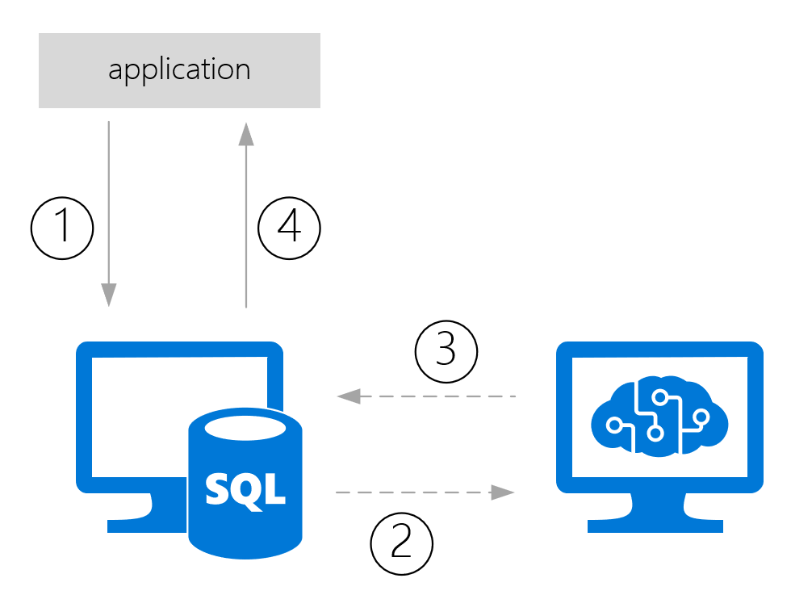
Advanced Analytics workflow: then and now
Traditionally Advanced Analytics processes extracted data
That data would be used for model training/scoring and then send back to wherever it came from
www.datamasterminds.io
Moving Advanced Analytics to your SQL Server databases
Notes:
1: Data from app is stored in a database
2: Data is pushed/pulled to model
3: prediction is returned and stored with the data
4: prediction returned to app from database

Slide 6
Advanced Analytics workflow: then and now
This process can be slow, especially when large datasets are involved
There is always data movement involved
How are we solving use-cases where (near) real-time scoring is required?
How are we handling model management and operationalization?
[ Demo time ]
www.datamasterminds.io
Moving Advanced Analytics to your SQL Server databases

Slide 7
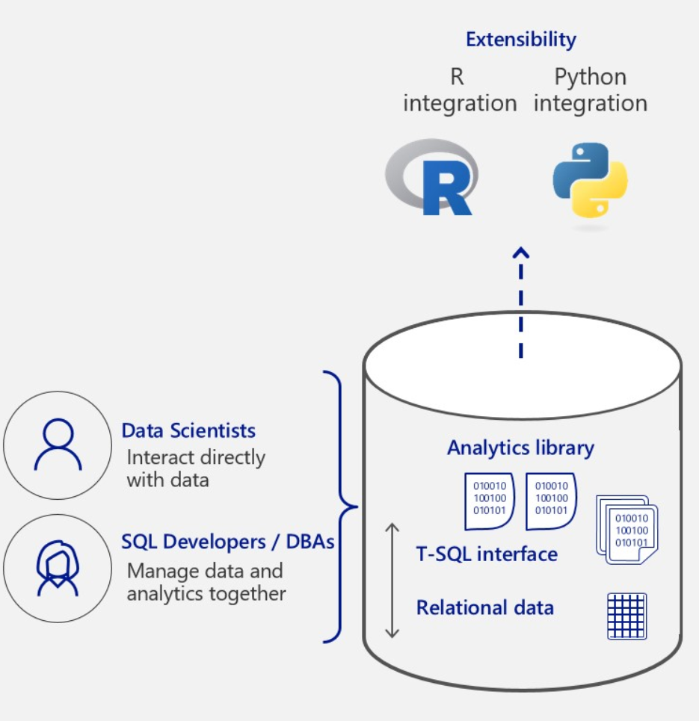
Advanced Analytics workflow: then and now
The solution: “in-database” analytics
New feature in SQL Server 2016 (R Services In-database)
Expanded in SQL Server 2017 (Machine Learning Services In-database)
Instead of bringing data to the model, we are bringing the model to the data
www.datamasterminds.io
Moving Advanced Analytics to your SQL Server databases
Notes:
2016 Introduced R support
2017 Expanded with Python
Advantages: No data movement, model management integrated in SQL Server, direct access to data

Slide 8
Building and exploiting in-database models
Three methods available for model training and scoring
sp_execute_external_script (SQL Server 2016)
sp_rxPredict (SQL Server 2016)
PREDICT (SQL Server 2017)
www.datamasterminds.io
Moving Advanced Analytics to your SQL Server databases

Slide 9
Building and exploiting in-database models
sp_execute_external_script
Supports both R and Python
Not dependent on RevoScaleR or MicrosoftML algorithms
External process
Requires in-database R or ML feature
sp_rxPredict
Fast!
Only R support
Requires CLR integration
Only supports RevoScaleR or MicrosoftML Algorithms
Only returns predictions
Requires in-database R or ML feature
PREDICT
Supports both R and Python
Fast
Easy TSQL integration
Does not requires in-database R or ML feature
Only SQL Server 2017
Only supports RevoScaleR algoritms
www.datamasterminds.io
Moving Advanced Analytics to your SQL Server databases

Slide 10
Building and exploiting in-database models
[ Demo time ]
www.datamasterminds.io
Moving Advanced Analytics to your SQL Server databases
Notes:
Demo 1: Automobile price prediction with in-database analytics

Slide 11
Azure Machine Learning integration
But what do you do when your model is stored inside Azure Machine Learning, but your data is on-premises inside a SQL Server database?
We can use sp_execute_external_script to write R/Python code to perform a call to the AzureML predictive experiment!
[ Demo time ]
www.datamasterminds.io
Moving Advanced Analytics to your SQL Server databases
Notes:
Normally we would need to push the data to AzureML
Demo 2: AzureML integration with the Iris model

Slide 12
Summary
We looked at the Advanced Analytics workflow and how in-databases analytics can impact it;
Build and stored a model directly in SQL Server;
Used the various methods to exploit the model and perform in-database predictions;
Connected to an Azure Machine Learning predictive experiment to score data inside SQL Server.
www.datamasterminds.io
Moving Advanced Analytics to your SQL Server databases

Slide 13
Questions?
www.datamasterminds.io
Moving Advanced Analytics to your SQL Server databases

Slide 14
Resources
Performing in-database predictions in SQL Server 2016/2017 https://bit.ly/2l4Q2ON
Accessing AzureML models through SQL Server In-database R Services https://bit.ly/2zC3SNt
Crazy Data Science http://www.crazydatascience.com
www.datamasterminds.io
Moving Advanced Analytics to your SQL Server databases

Slide 15



DataMasterminds BV
Bredeweg 43-2, 1098 BN Amsterdam
info@datamasterminds.io

